Slide 1
AMC Series Media Converter
Introduction

Slide 2
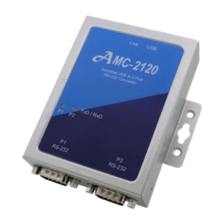
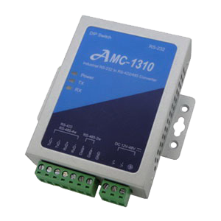
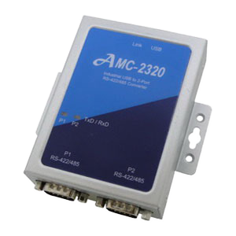
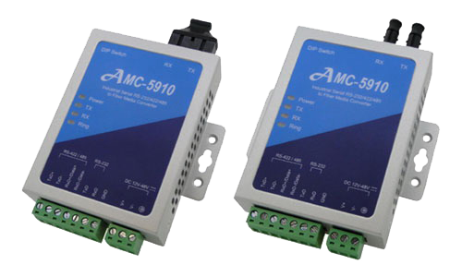
AMC Series
AMC-1310
AMC-2120
AMC-2320
AMC-5810
AMC-5910

Slide 3
AMC-1310
Industrial RS-232 to RS-422/485 Converter
Features
RS-232 to RS-422/485 converter
Speed up to 921.6Kbps
Auto baud rate and direction control
3KV isolation and 15KV ESD protection
Wide range power input (12V to 48Vdc)
Wide operating temperature (-40 to +70°C)
Configuration by DIP switch
Terminator and biasing resisters setting by DIPs

Slide 4
AMC-2120
Industrial USB to 2-Port RS-232 Converter
Features
Compliant USB 1.1/2.0 for up to 480 Mbps speed
All RS-232 speed up to 921.6 Kbps
15KV ESD protection for all RS-232 signals
2.5KV isolation between USB and RS-232 port
Low power consumption with USB bus powered
USB Drivers provided for Windows and Linux OS
Din-Rail mount or wall mount robust housing
Wide operating temperature (-40 to +70°C)

Slide 5
AMC-2320
Industrial USB to 2-Port RS-422/485 Converter
Features
Compliant USB 1.1/2.0 for up to 480Mbps speed
2-port RS-422/485 speed up to 921.6 Kbps
Supports terminator and biasing functions
15KV ESD protection for all RS-422/485 signals
2.5KV isolation between USB and RS-422/485 interface
Low power consumption with USB bus powered
USB Drivers provide for Windows and Linux OS
Din-Rail mount or wall mount robust housing
Wide operating temperature (-40 to +70°C)

Slide 6
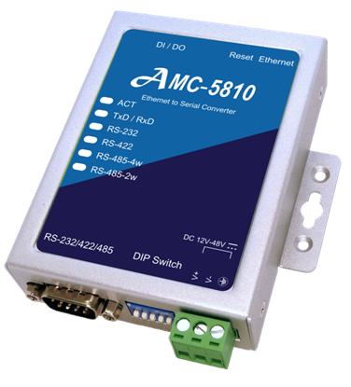
AMC-5810
Industrial Ethernet to Serial Converter
Features
Ethernet 10/100Base-TX transmission
RS-232/422/485 speed up to 230.4 Kbps
Supports terminator and biasing functions
15KV ESD protection for all RS-232/422/485 signals
2.5KV isolation between device and all serial interface
Supports terminator and biasing resistor via DIP switch
3-CH DI and 3-CH DO
Din-Rail mount or wall mount robust housing
Wide operating temperature (0 to +70°C)

Slide 7
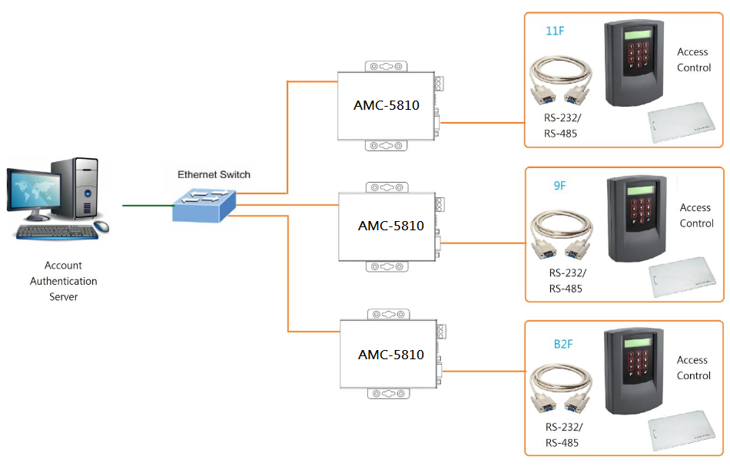
AMC-5810 Application
Industrial Ethernet to Serial Converter
Access Control

Slide 8
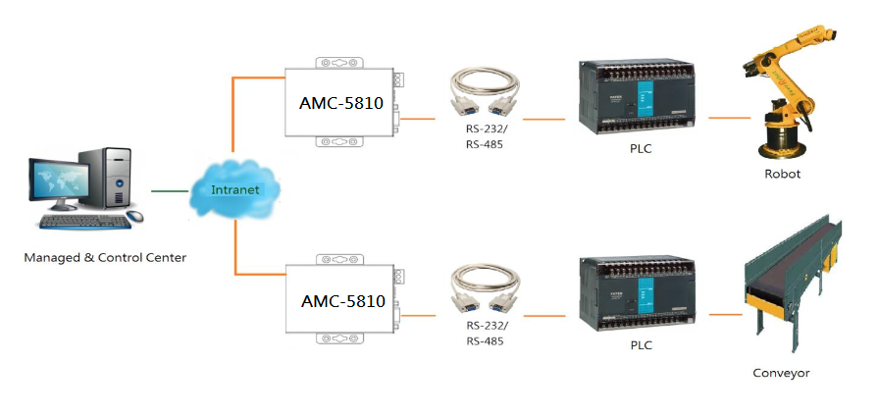
AMC-5810 Application
Industrial Ethernet to Serial Converter
Factory Automation

Slide 9
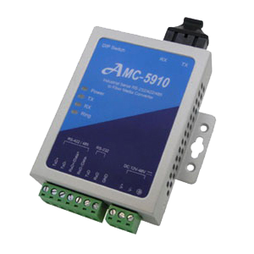
AMC-5910
Industrial Serial RS-232/422/485 to Fiber Converter
Features
Industrial serial to fiber media converter
Speedup to 115.2 Kbps
Peer to Peer or SFR for serial fiber ring communication
Auto baud rate and direction control
Multi-mode 5 km, Single mode 60Km
15KV ESD protection
Wide range power input from 12V to 48Vdc
Wide operating temperature (-40 to +70°C)
Terminator and biasing resisters by DIP switch
1X9 Standard ST/SC Fiber Transceiver

Slide 10
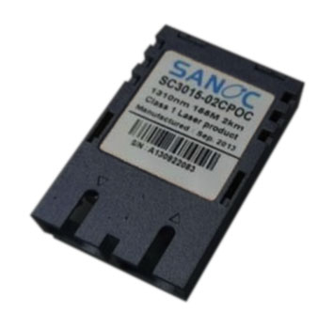
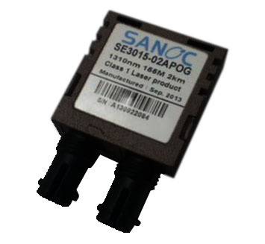
AMC-5910
Industrial Serial RS-232/422/485 to Fiber Converter
Fiber Transceiver
1310nm, Multi mode, 5km
1X9 Standard SC Fiber Transceiver
1310nm, Multi mode, 5km
1X9 Standard ST Fiber Transceiver

Slide 11
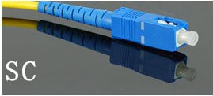
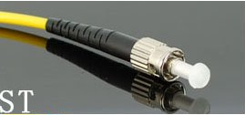
AMC-5910
Industrial Serial RS-232/422/485 to Fiber Converter
Fiber Connecter type
SC Type Connecter
ST Type Connecter

Slide 12
AMC-5910
Industrial Serial RS-232/422/485 to Fiber Converter
Fiber Connecter type
SC Type Connecter
ST Type Connecter

Slide 13
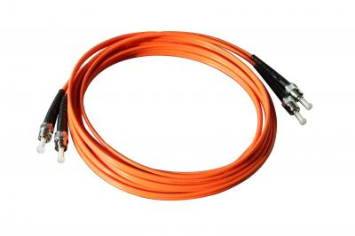
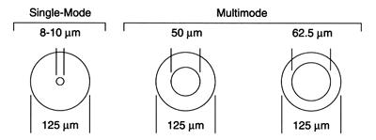
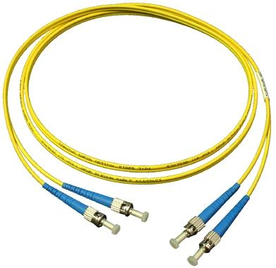
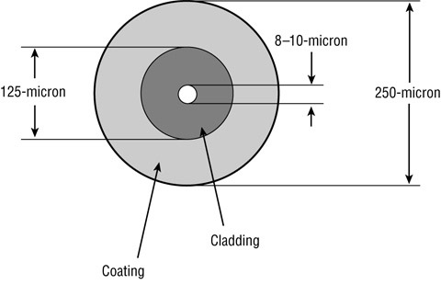
AMC-5910
Industrial Serial RS-232/422/485 to Fiber Converter
ST Fiber Optic Duplex Patch Cord - 3 Meter Multi Mode
62.5/125um
ST Fiber Optic Duplex Patch Cord - 3 Meter Single Mode
9/125um

Slide 14
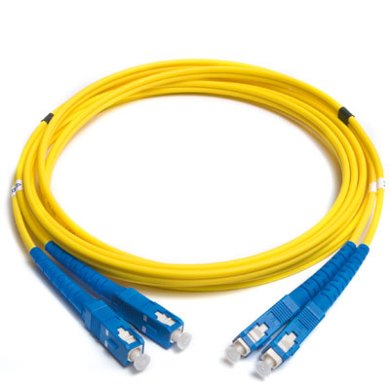
AMC-5910
Industrial Serial RS-232/422/485 to Fiber Converter
SC Fiber Optic Duplex Patch Cord - 3 Meter Multi Mode
62.5/125um
SC Fiber Optic Duplex Patch Cord - 3 Meter Single Mode
9/125um

Slide 15
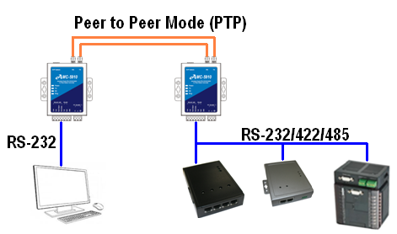
AMC-5910
Industrial Serial RS-232/422/485 to Fiber Converter
Fiber Media Converter using RS-232 or RS-422 or RS-485 in PTP mode

Slide 16
AMC-5910
Industrial Serial RS-232/422/485 to Fiber Converter
Fiber Media Converter using RS-232 in PTP mode

Slide 17
AMC-5910
Industrial Serial RS-232/422/485 to Fiber Converter
Fiber Media Converter using RS-485 2-wire in PTP mode

Slide 18
AMC-5910
Industrial Serial RS-232/422/485 to Fiber Converter
Fiber Media Converter using RS-485 4-wire in PTP mode

Slide 19
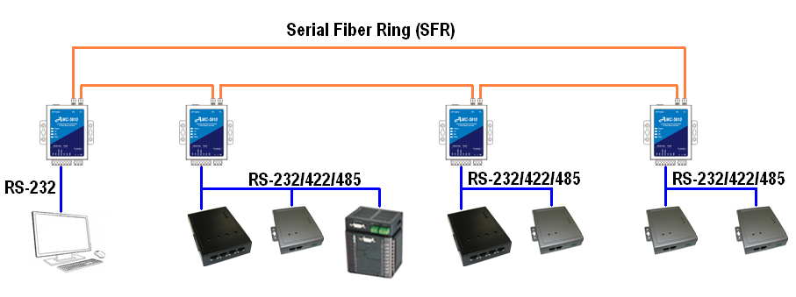
AMC-5910 Application
Industrial Serial RS-232/422/485 to Fiber Converter
Fiber Media Converter using RS-232 or RS-422 or RS-485 in SFR mode

Slide 20
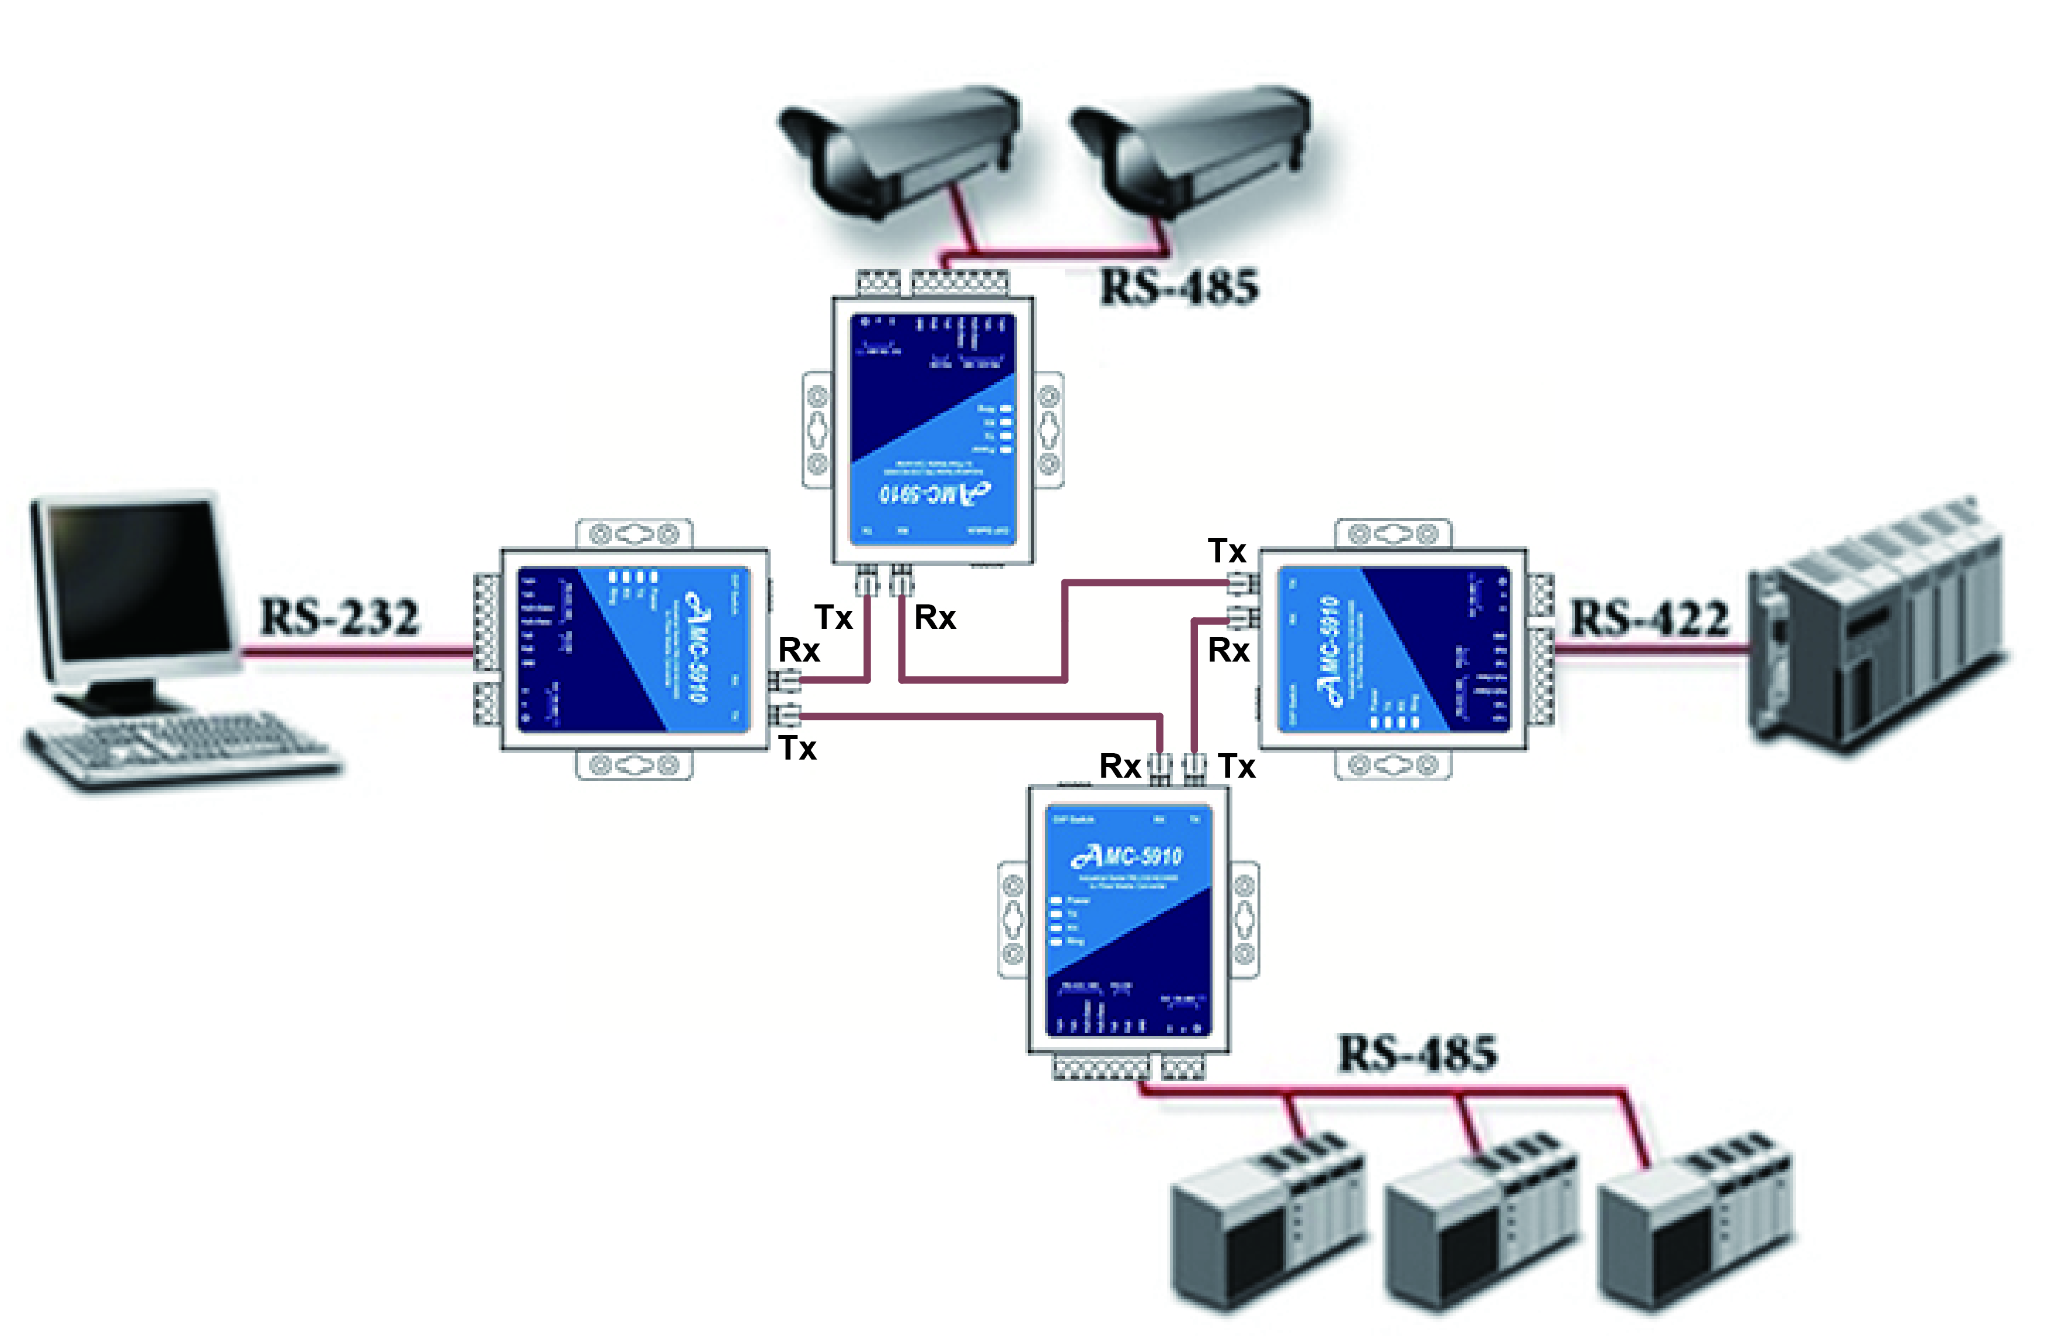
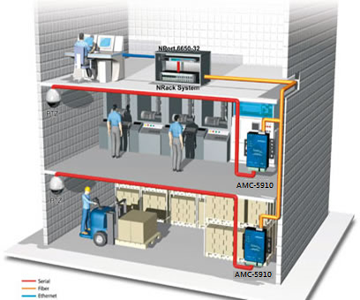
AMC-5910 Application
Industrial Serial RS-232/422/485 to Fiber Converter
Remote monitor and PLC control

Slide 21
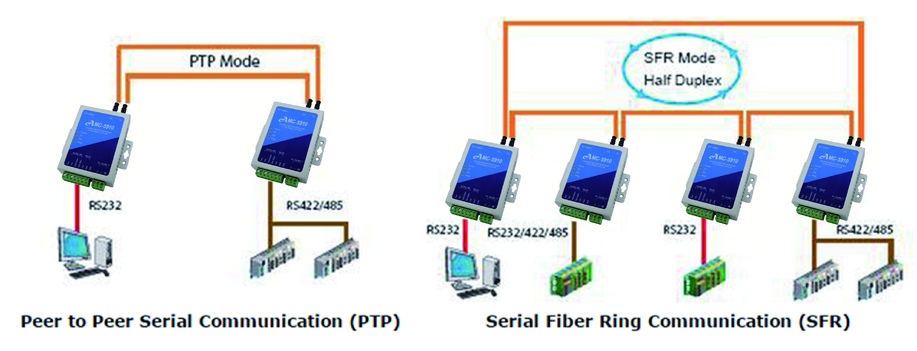
AMC-5910 Application
Industrial Serial RS-232/422/485 to Fiber Converter
Connection mode example

Slide 22
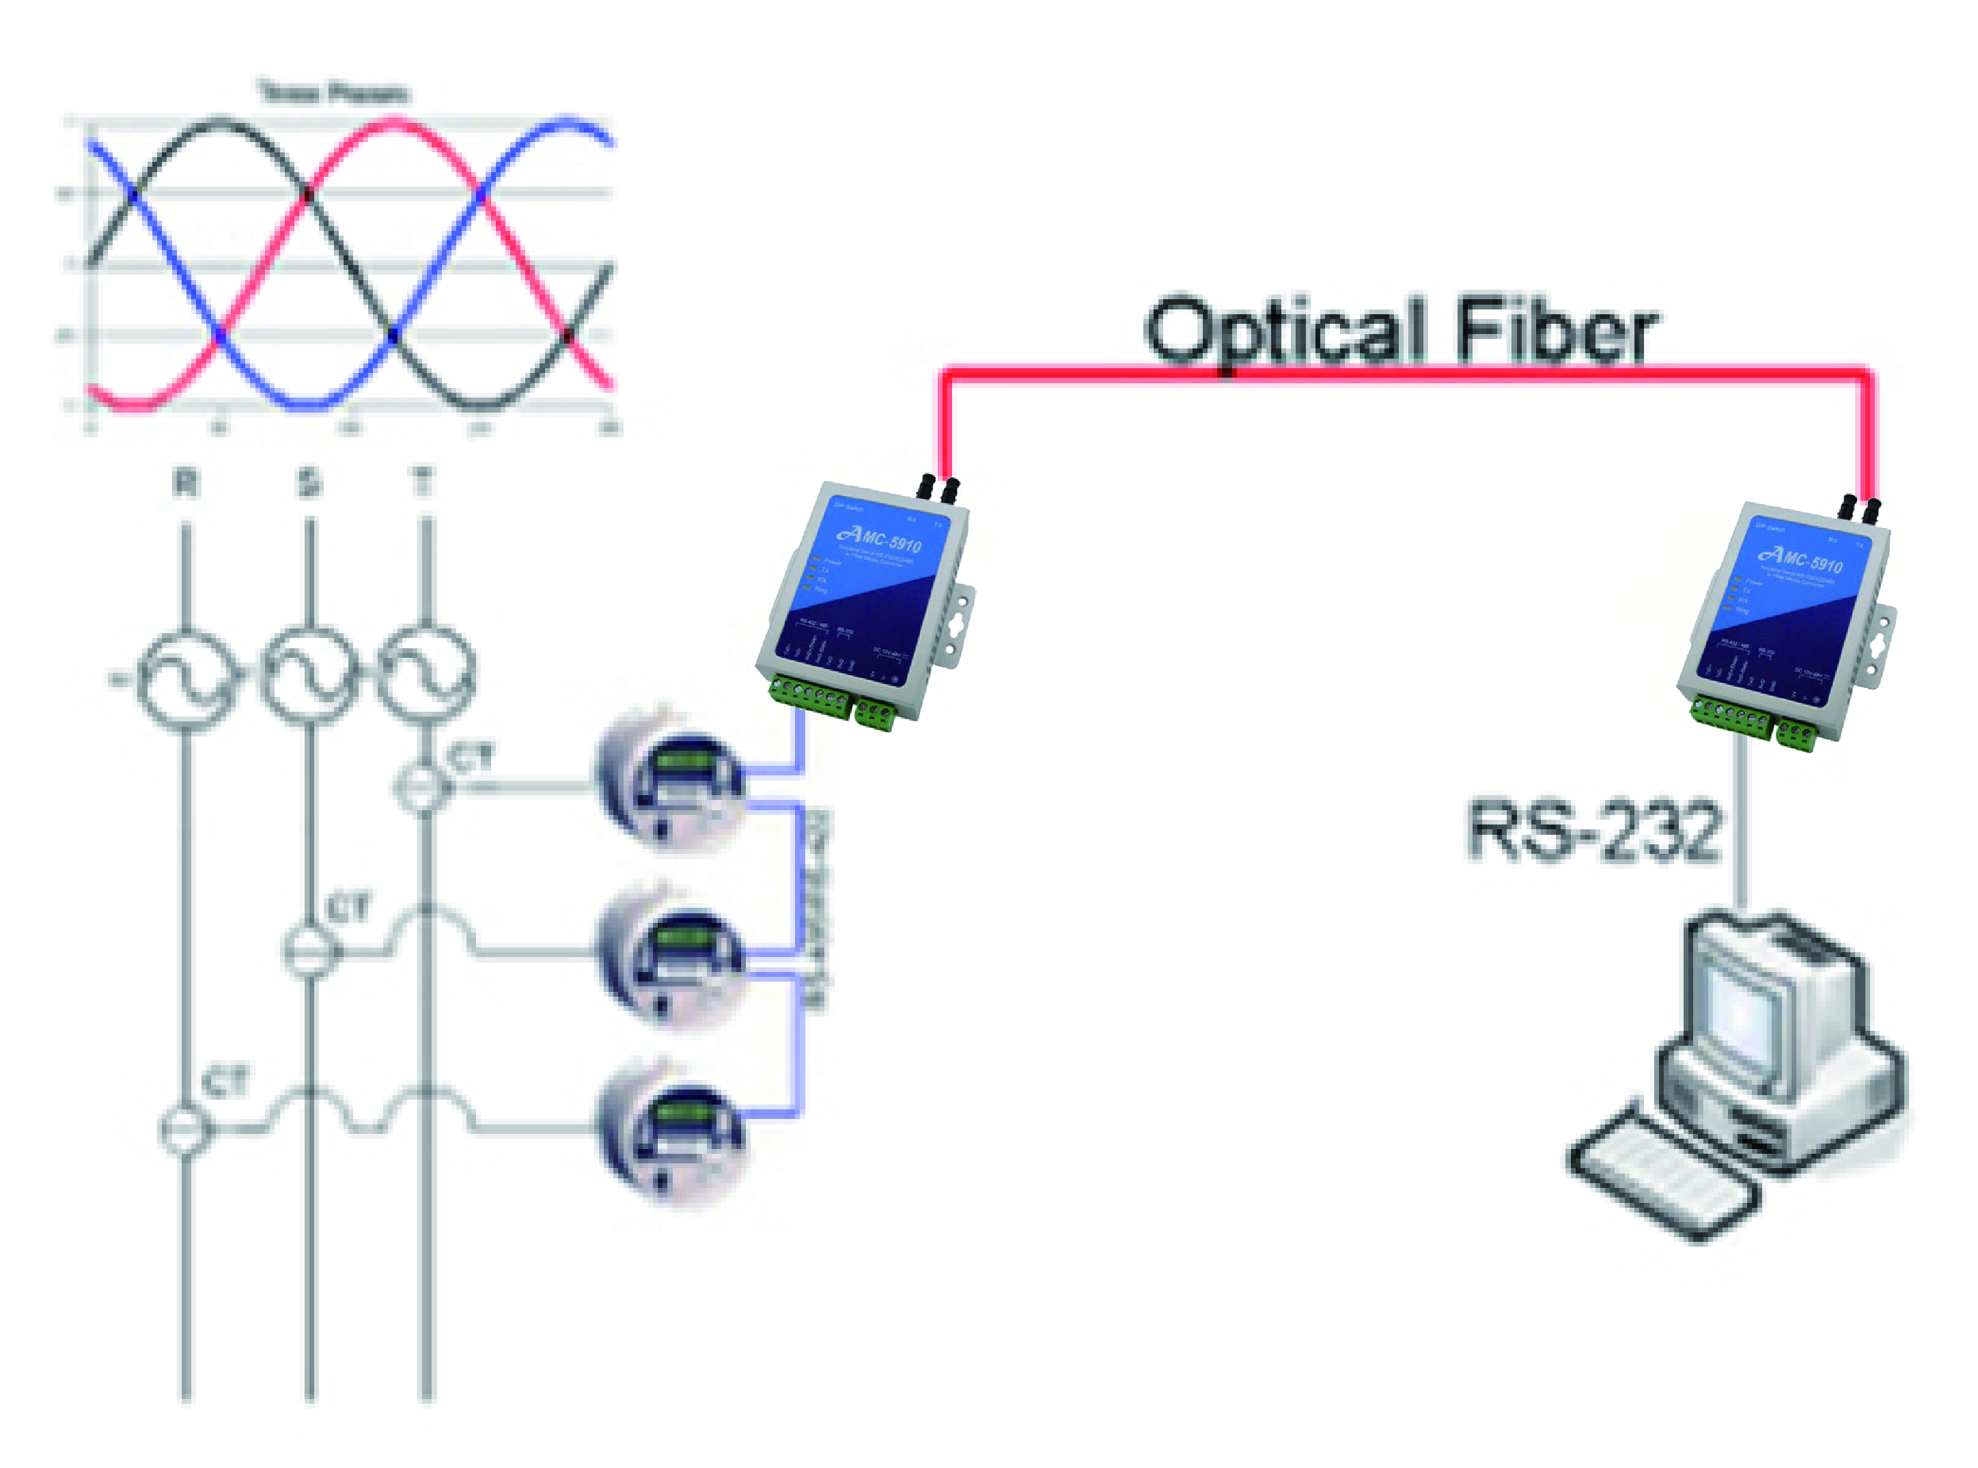
AMC-5910 Application
Industrial Serial RS-232/422/485 to Fiber Converter
Application ex. Remote monitoring of power measuring

Slide 23
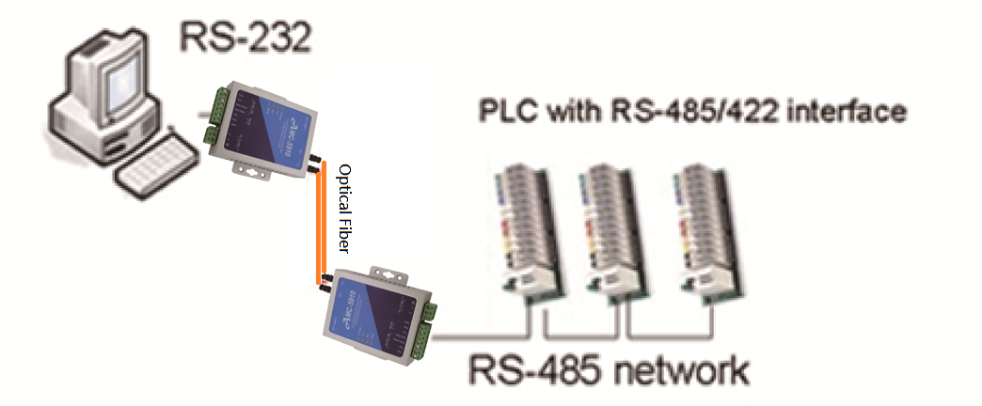
AMC-5910 Application
Industrial Serial RS-232/422/485 to Fiber Converter
Application ex. PLC Remote Control

